Slide 1
10 Reasons You MUST Consider
Pattern-Aware Programming
By Gael Fraiteur (@gfraiteur),
Founder & CEO of PostSharp Technologies
#1 pattern-aware compiler extension to C#/VB

Slide 2
Housekeeping Rules
Q&A session at the end.
Please write questions to GoToMeeting chat window.
The webinar recording will be made available on Friday, July 22th.

Slide 3
The Problem: Repeating Code (Boilerplate)

Slide 4

Thinking with Patterns
Developers think
at a high level of abstraction,
using design patterns.
Window pattern, repeated 200x
Door pattern, repeated 20x

Slide 5

Conventional Compilers Are Limited
Conventional compilers don’t have a concept of patterns.
Therefore developers write repeating code: boilerplate code.

Slide 6
Typical Boilerplate
INotifyPropertyChanged
Undo/redo
Code contracts (preconditions)
Logging
Transaction handling
Exception handling
Thread dispatching
Thread synchronization
Immutable
Authorization
Audit
Caching

Slide 7

Consequences of Boilerplate
High development effort
Poor quality of produced software
Code is more complex than necessary
  Difficulty to add/modify functionality after release 1.0
  Slow ramp-up of new team members
Can you see how boilerplate code slows your development team?

Slide 8

The Big Question
How can we produce high-quality software with less development effort... without having to replace your existing compiler?

Slide 9
The Solution

Slide 10
Inadequate Technologies
Dependency Injection
  Just adds behaviors to component boundaries
  Affects your architecture
  Only supports basic patterns
  Great tool, but not for that job.
Code Generators / Refactoring Tools
  Just makes it easy to generate boilerplate
  You still have to maintain it!

Slide 11
Converging Technologies
Metaprogramming
Static Program Analysis
Aspect-Oriented
Programming
Pattern-Aware Compilers
Dynamic Program Analysis
Threading Patterns
Design Patterns

Slide 12
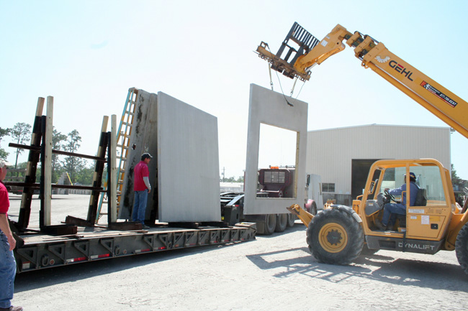
Pattern-Aware Compiler Extensions
Add support for patterns
No more pattern hand-coding resulting in boilerplate!

Slide 13

1) Stop Writing Boilerplate and Deliver Faster
4 REASONS FOR PATTERN-AWARE COMPILERS
Fewer lines of code means fewer hours of work
  Outsource repetitive work to compiler
  and save time and costs immediately

Slide 14

2) Build More Reliable Software
4 REASONS FOR PATTERN-AWARE COMPILERS
Fewer lines of code means fewer defects
Reliability becomes much more affordable
  Reliability generally means boilerplate: logging, exception handling, caching, security,…
  The “right” tool.

Slide 15

3) Easier to Modify Functionality
4 REASONS FOR PATTERN-AWARE COMPILERS
Cleaner and shorter code is easier to understand
  Focus on business logic and save time trying to understand the code
Better architecture is future-proof
  Define features such as logging, exception handling or transactions in one place and make their modification easy and fast

Slide 16

4) New Team Members Contribute Quicker
4 REASONS FOR PATTERN-AWARE COMPILERS
Simpler code means faster ramp-up
  New team members can focus on business logic
  without worrying about complex architectural structures.
Implement a tighter feedback loop
  Validate hand-written code against
  your defined rules at build time
  and detect bugs as quickly

Slide 17
Top 10 Features to Look For
Ready-made pattern implementations
Threading models
Ability to automate complex patterns
Ease to add patterns to source code
Compatibility with existing codebase
Build-Time Validation of Patterns
Architecture Validation
Integration with Visual Studio
Run-Time Performance
Commercial Support

Slide 18

1) Ready-Made Pattern Implementations
10 FEATURES TO LOOK FOR
Don’t reinvent the wheel.
Would you code your own Graph or DataGrid
controls?
Look for off-the-shelf pattern implementations.
Demo: INotifyPropertyChanged, undo/redo

Slide 19

2) Threading Models
10 FEATURES TO LOOK FOR
Build thread-safe applications!
Simpler: Use the right level of abstraction. Don’t overwhelm your brain with thousands of tiny details.
Your choice: Immutable, Freezable, Synchronized,
Reader-Writer Synchronized, Actor, Thread Affine and Thread Unsafe.
No more random bugs: Model validation catches most defects during build or during single-threaded test coverage.

Slide 20
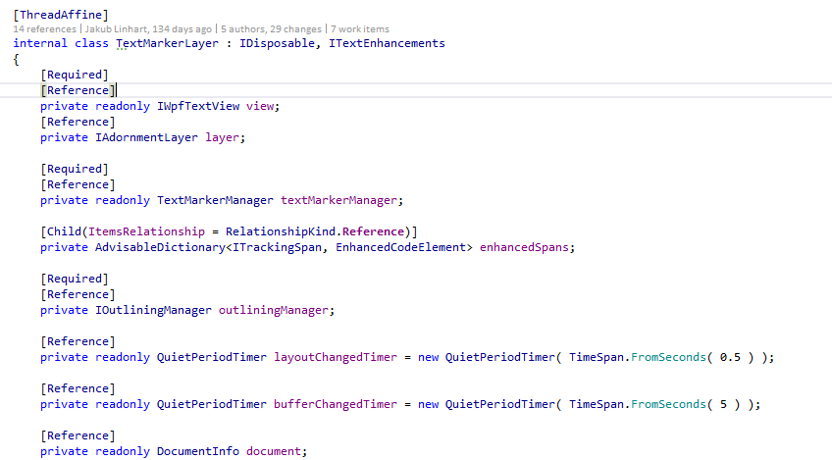
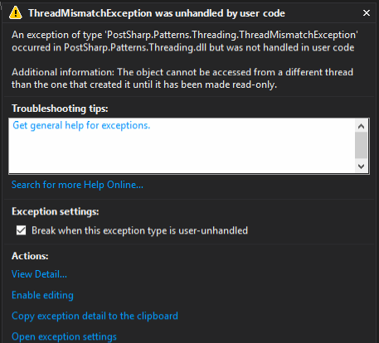
Thread Safety: Example
10 FEATURES TO LOOK FOR
2.
1.

Slide 21
3) Automate Complex Patterns
10 FEATURES TO LOOK FOR
  Rich set of primitive transformations
    Decoration: methods
    Interception: methods, properties, fields, events
    Introduction: methods, properties, fields, interfaces, custom attributes
    To any declaration… or just public virtual ones?
  Aspects composed of several transformations
  Several aspects on the same declaration
  Simple API… or complex AST/MSIL transformations?
  Validation of hand-written code against pattern guidelines.

Slide 22
Example: Weak Event Pattern
10 FEATURES TO LOOK FOR
Challenge: Lifetime of event subscriptions controlled by the event client, not the event source.
Solution: 2 aspects, 1 validation
1. Client adds handler to event.
2. Event stores only weak reference thanks to [WeakEvent] aspect
class MyEventSource
{
}
[WeakEventClient]
class MyEventClient
4. [WeakEventClient] aspect implements IWeakEventClient interface and stores strong reference to event handler.
1.
2.
[WeakEvent]
event EventHandler MyEvent;
3.
3. Event adds handler to source
through IWeakEventClient

Slide 23
4) Easy to Add Patterns to Code
10 FEATURES TO LOOK FOR
  Custom attributes: one by one, hand-picked.
  Multicast attributes: bulk
  e.g. add logging to all public methods
  Inheritance
  XML: centrally managed.
  Programmatic at Build-Time: more flexible.
  Programmatic at Run-Time: cool but not a compiler technology

Slide 24

5) Compatibility with Existing Codebases
10 FEATURES TO LOOK FOR
Design Neutrality
  No impact on architecture
  Don’t abuse from dependency injection
Plain C# and VB
  Get the benefits of F#, Scala, Nemerle, Python, Ruby or JavaScript in C# and VB
Cross-platform
  Supports .NET Framework, Windows Phone, WinRT, Xamarin and Portable Class Libraries

Slide 25

6) Build-Time Pattern Validation
10 FEATURES TO LOOK FOR
10% of developers design patterns and
implement them with aspects.
90% of developers use aspects.
  Emit build-time errors and warnings
  Declarative and programmatic validations

Slide 26
7) Architecture Validation
10 FEATURES TO LOOK FOR
  Challenge: get large teams respect conventions.
    “Everybody on the team shall solve this problem this specific way”.
    It’s a pattern but it still needs manual work.
  Traditional Solution: Code Review
    Slow feedback loop
    Generates relationship friction
  Better solution: Automatic Validation
    Express conventions as executable code
    Break the build in case of non-compliance.

Slide 27
8) Visual Studio Integration
10 FEATURES TO LOOK FOR
  Key questions developers have when coding:
  What is this piece of code doing?
  → Which aspects are applied here?
  Where is this aspect being used?
  Debugging the business logic with / without the aspects.

Slide 28

9) Run-Time Performance
10 FEATURES TO LOOK FOR
Build-time technology
  Code modification at build time
  Don’t waste time on analysis at run-time
No reflection at run-time

Slide 29
10) Commercial Support
10 FEATURES TO LOOK FOR
  Who backs the product?
    Master thesis work vs vested professional software engineers
  Support
    Can you get someone on the phone?
  Documentation
  Quality policies

Slide 30
What’s Holding You Back?
Will I be able to understand my code?
  Yes. With proper Visual Studio tooling, you’ll easily understand where and how patterns are used in your code
Can I still debug my code?
  Yes. The debugging experience is unaffected.
Compilation will be slower
  Possibly. Smarter compilers introduce additional steps into the compilation, there is a performance cost.

Slide 31


Return on Investment
Each line of code costs $14. A commercial tool typically pays off after a developer saves first 50 lines of code.
Pattern-aware compilers can reduce source code by up to 20%. That means $5,000-$20,000 per developer per year!
15 to 55 times ROI.
You never lose – you always win.

Slide 32

Picture this
No more boring and repetitive coding.
No more spending hours trying to understand the business logic of the code.
No more random errors in multithreaded applications.
Smoother code reviews.
Cut development and maintenance costs.
Go to market faster.
Produce high-quality, easy-to-maintain software that has fewer bugs – with less development effort.
Life is Good!

Slide 33
This webinar is brought to you by…
#1 best-selling pattern-aware compiler extension to C#/VB

Slide 34
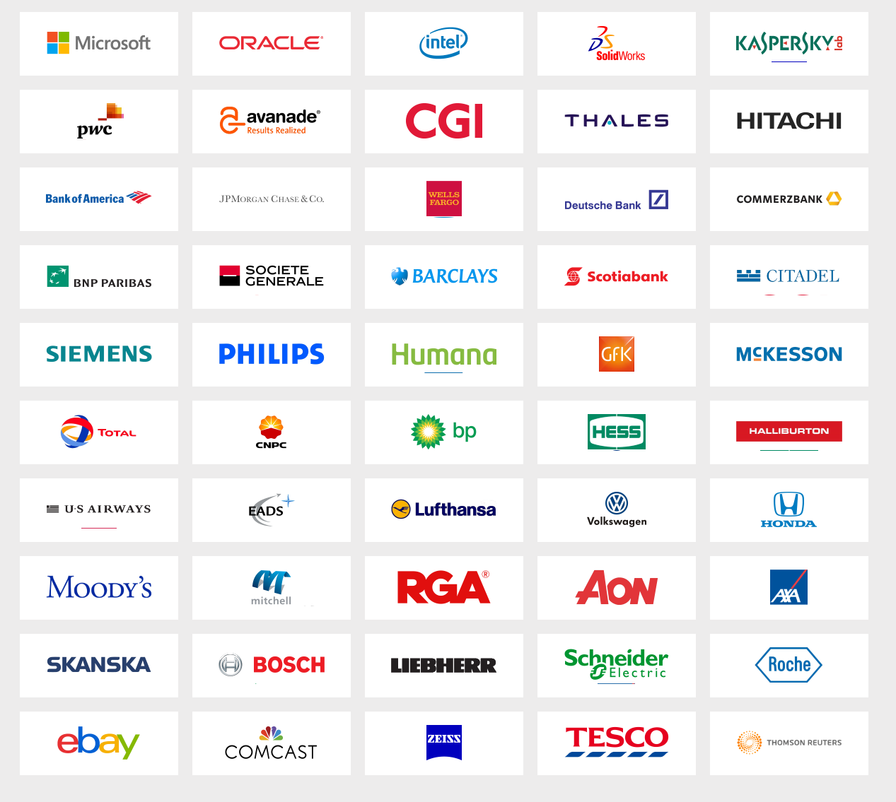
Trusted by the World’s Largest Corporations
Trusted by over 50,000 satisfied developers worldwide
Over 1,000 of the world’s largest corporations
More than 10% of all Fortune 500 companies rely on PostSharp
All trust…

Slide 35

For More Information
Go to www.postsharp.net/download
and start the free trial.
Download the white paper from
https://www.postsharp.net/product/white-papers.
Read case studies and testimonials
on www.postsharp.net/customers.
Contact us at hello@postsharp.net
with any questions.

Slide 36

Questions?

Slide 37
#1 best-selling pattern-aware compiler extension to C#/VB

